Slide 1
Introduction to Image registration

Slide 2
Introduction
Image registration (also called image matching) is an important problem in image analysis with many applications:
Several images of the same object are taken using different imaging modality
Several images of the same object are taken at different time instants
It is necessary to compare two objects
It is desired to match an image to a model (e.g. digital atlas)

Slide 3
The Problem
The problem of image registration is to determine an unknown geometric transformation that maps one image into another (to a certain degree of accuracy)
In other words, after registration problem is solved, for each pixel in the first image we know the corresponding pixel in the second image
This assumes that the images are similar in the sense that both images contain the same (or similar) object, which may be rotated, translated, or elastically deformed

Slide 4
The Problem
In medical applications, image registration is usually done for two-dimensional and three-dimensional images
In general, registration problem can be solved in any number of spatial or temporal dimensions

Slide 5
Motivation
When two images are registered it is possible to:
Analyze (detect) differences between the images (e.g. images taken at two different time instants or difference between the template and a tested product in visual inspection)
Combine information contained in multiple images into a single image (image fusion) with the goal of easier interpretation by humans (e.g. in radiology it is possible to do multimodality image registration – MR to CT, etc.)

Slide 6
Information Integration
Information integration has the goal of combining several pieces of information into a single one
E.g. merge several images into a single one
In the context of image processing this is called image fusion
There are several probabilistic theories for information integration such as:
Bayesian approach

Slide 7
Applications: Remote Sensing
In remote sensing (e.g. meteorology) the same geographical area may be imaged in various spectral ranges
In management of urban areas it is possible to take images of an urban area in regular time intervals and detect changes (e.g. new buildings)

Slide 8
Applications: Medicine
Biomedicine is an important application area
Developments in medical imaging resulted in powerful imaging modalities providing information about anatomy and function of the human body:
Computed tomography (CT)
Magnetic resonance (MR)
Ultrasound
Positron emission tomography (PET)
Single photon emission computed tomography (SPECT)
Gamma camera imaging
X-ray imaging

Slide 9
Applications: Medicine
Medical image registration is required for:
Use of different imaging modalities (e.g. MR/PET, MR/CT)
Progressive disease tracking (imaging in regular time intervals and detection of changes, e.g. for tumor treatment evaluation)
In computer assisted surgery (e.g. in neurosurgery preoperative MR images may be registered with intraoperative MR images for surgical navigation)
Matching of patient images to a model (e.g. for atlas guided image analysis)

Slide 10
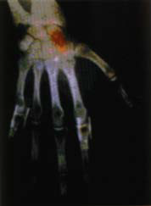
Example: Hand Registration
X-ray image (anatomical information)
Nuclear medicine image (functional information)
After registration, hand image obtained by nuclear medicine imaging is pseudo-colored and superimposed on the gray scale X-ray hand image
Red color corresponds to the largest isotope concentration

Slide 11
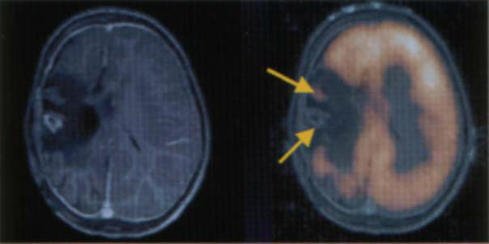
Example: Brain Registration
MR image showing anatomy (left), PET FDG image showing function superimposed on MR image (right)

Slide 12
Image registration methods
Registration methods can be classified with respect to several different criteria such as:
Dimensionality of images that are registered (2-D, 3-D, 4-D methods)
Image features being matched (extrinsic and intrinsic methods)
Mechanism of interaction with the user
Type of geometric transformation used for registration

Slide 13
Dimensionality
We can register 2-D, 3-D, or 4-D images
3-D registration can be done for two 3-D images or for a temporal sequence of 2-D images (video)
If we want to register a sequence of 3-D images this represents a 4-D registration problem
There is also a problem of 2-D image (perspective projection of 3-D space) to 3-D image registration
In this case it is necessary to determine the view parameters so that the obtained perspective transformation of 3-D image matches the 2-D image

Slide 14
Image Features
This classification is motivated by the type of image features used for image registration:
Extrinsic methods (external objects or markers are used as reference points for registration)
Intrinsic methods (registration is based on pixel values – no external objects are used)

Slide 15
Extrinsic Method
Extrinsic methods use artificial external objects (markers) attached to the object to be registered
Markers are detected in both images and used for registration
Example: For brain image registration skin markers or stereotactic frames may be used
Disadvantage: Registration is based on external markers so accuracy depends on the accuracy of marker detection (segmentation is required)

Slide 16
Intrinsic Methods
Intrinsic registration methods do not use artificial external objects
Intrinsic methods use:
anatomical landmarks (points, contours, or surfaces), or
pixel values (intensity-based methods)
Anatomical landmarks must be detected and this represents a disadvantage (possibility of error)
Intensity-based methods have advantage of relying only on pixel values without the need for detection of special landmarks

Slide 17
User Interaction
With respect to user interaction, registration
methods can be divided into:
􀁺 Interactive (require user interaction to define the geometric
transformation for registration):
􀁺 Semi-automatic (user interaction is only required for
initialization, guidance, or stopping the registration
procedure)
􀁺 Automatic (do not require any user interaction)

Slide 18
Geometric Transformation
This classification is based on the type of transformation used for registration:
Rigid registration: distance between any two object points is preserved (rotation, translation)
Affine transformation: A line is mapped into a line, parallelism between lines is preserved
Projection transformation (e.g. perspective projection) is like affine, but it does not preserve parallelism of lines
Elastic transformation: line is mapped into a curve

Slide 19
Geometric Transformation
Rigid transformations are a subset of affine transformations
Affine transformations are a subset of projective transformations
Projective transformations are a subset of elastic transformations

